Slide 1
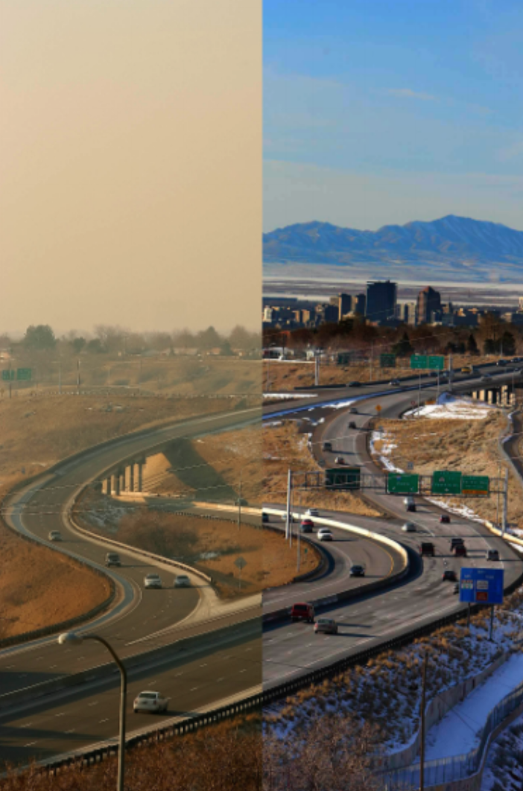

Air Quality and U: Improving Air Quality Monitoring in SLC
Dylan Wootton

Slide 2
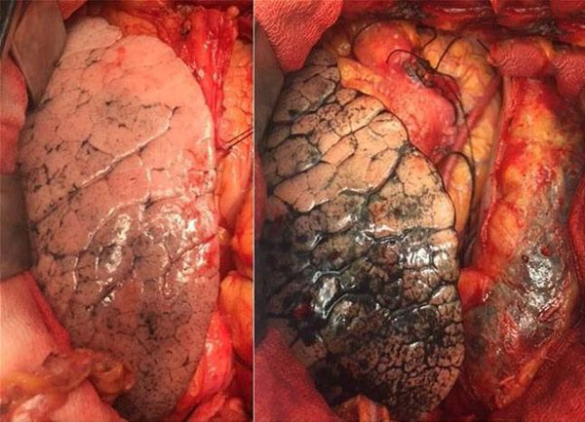
Poor Air Quality Causes Irreversible Damage to Cardiac and Respiratory Health.¹
50 years of clean air (rural)
50 years of air pollution (city)
Poor air quality leads to 2,000 premature deaths of Utah residents each year.²
[1] - Yu-Fei Xing. Thoracic Disease. January 2016. Pg 69 – 74.
[2] - Brian Moench. Salt Lake Tribute. Jan 24th 2013. Full Article.
Notes:
Super scripts (Possibly cleaner). On the slide have the first author the abbr journal, the volume, year, and page number. [no title, just the date]/
Cite the images.

Slide 3
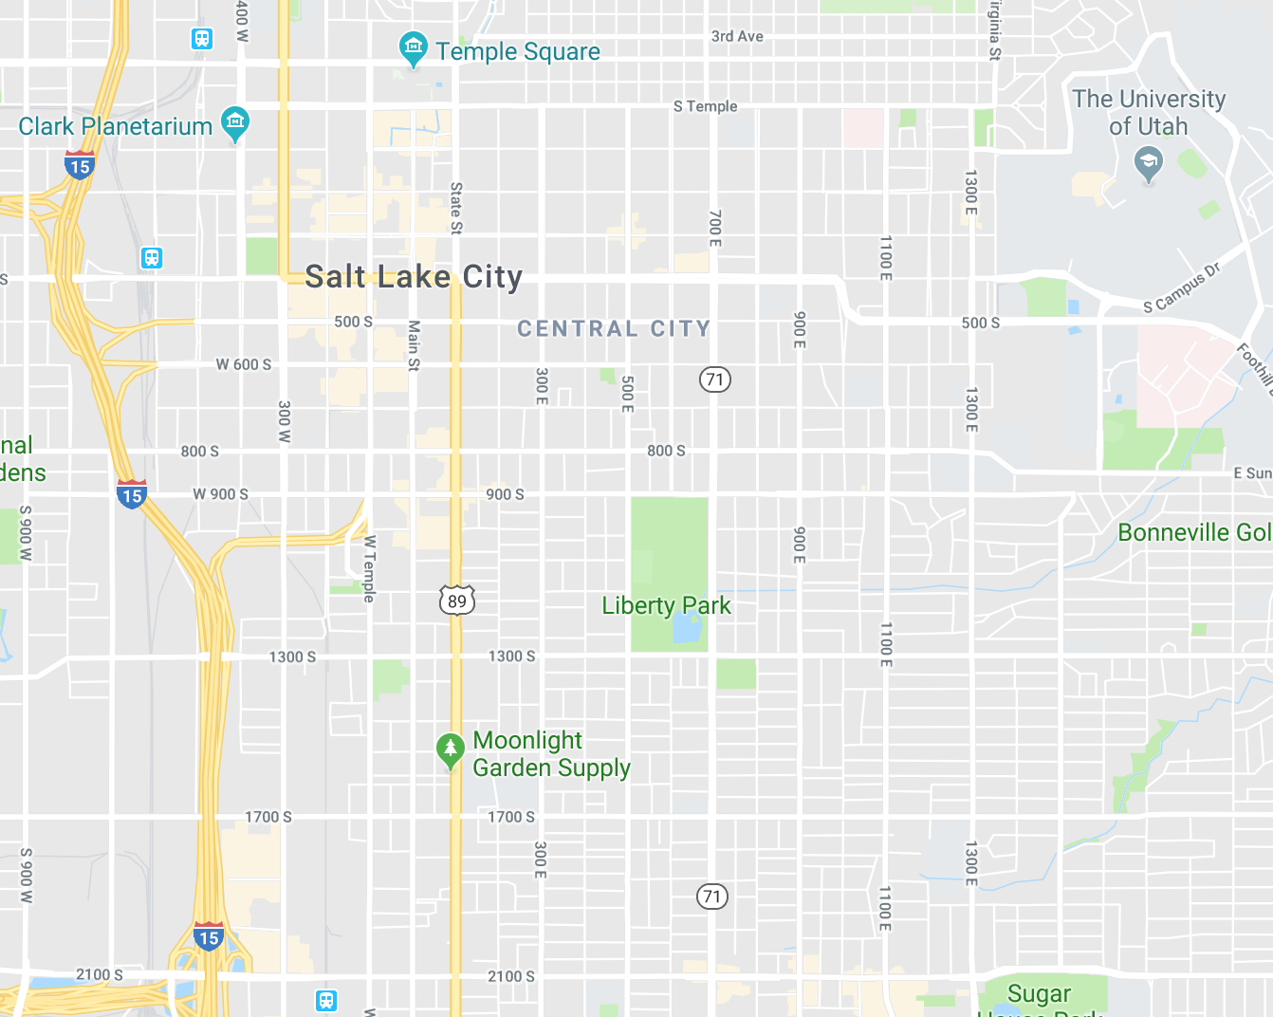

BAD

Slide 4
BAD
REAL
BAD
We lack the data to make informed decisions about air quality.
BAD
LESS
BAD
MORE
BAD
The severity of air pollution can vary significantly, even between distances of 50 meters.³
[3] S. Steinle. Total Environment. Jan 2013. 183-193

Slide 5
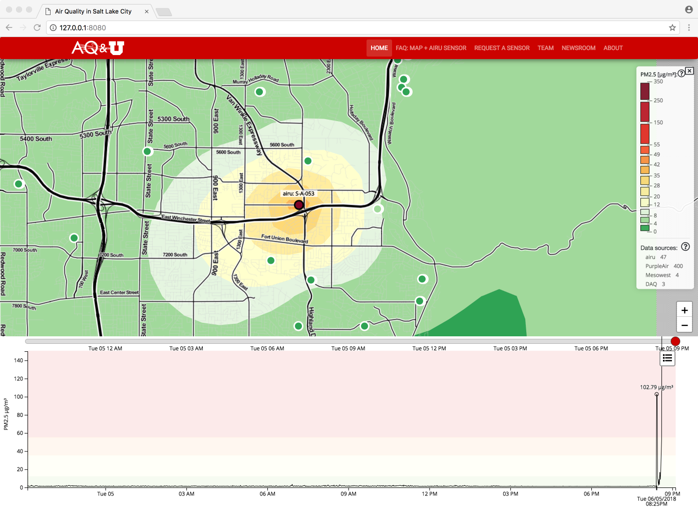
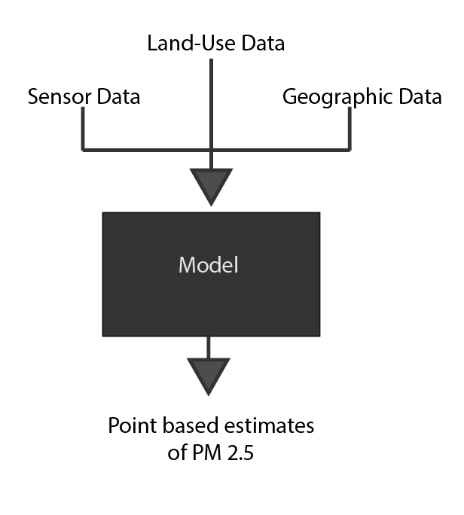
Sensors are too expensive to cover all areas.
We strategically placed sensors and use a model to interpolate between them.
Notes:
Make the model picture bigger. Look into changing the legend into a larger legend. Make the spike a separate slide (where it fills it).

Slide 6


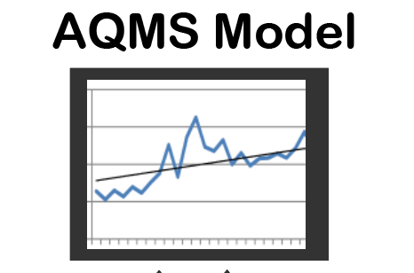
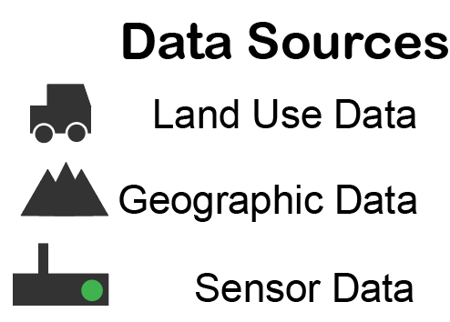

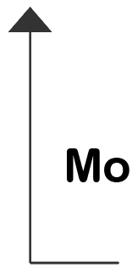

The past workflow failed to help engineers understand the data.
?

Slide 7
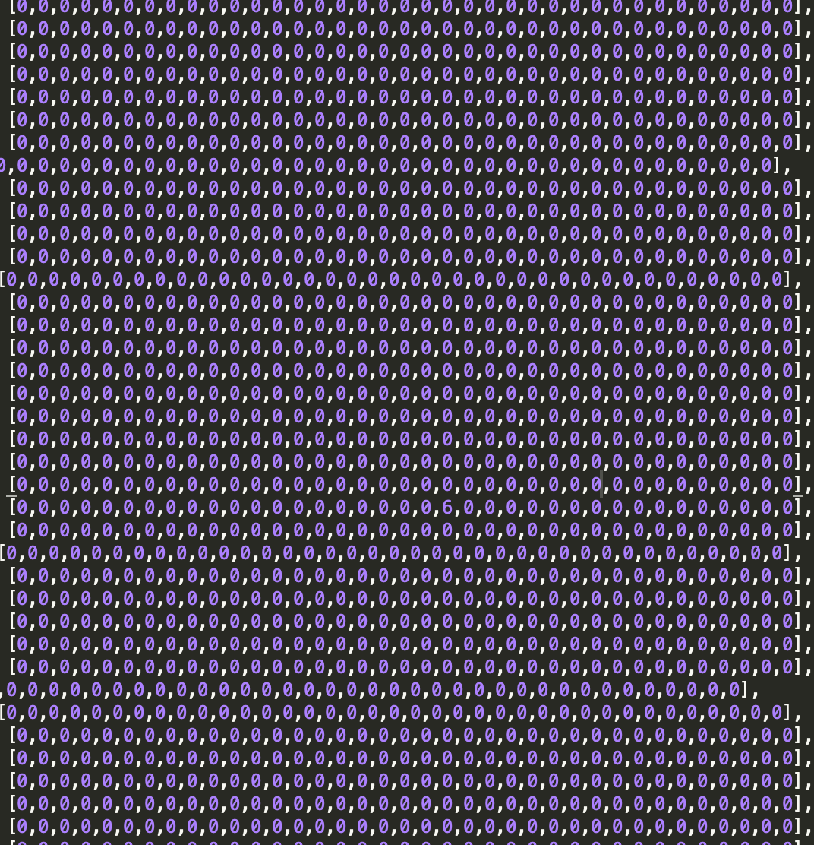

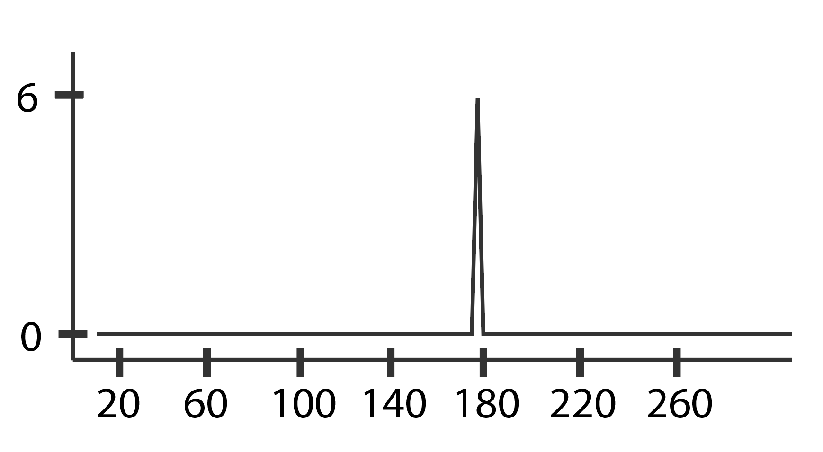
Engineers had no way of interfacing with the data in a reasonable way.

Slide 8
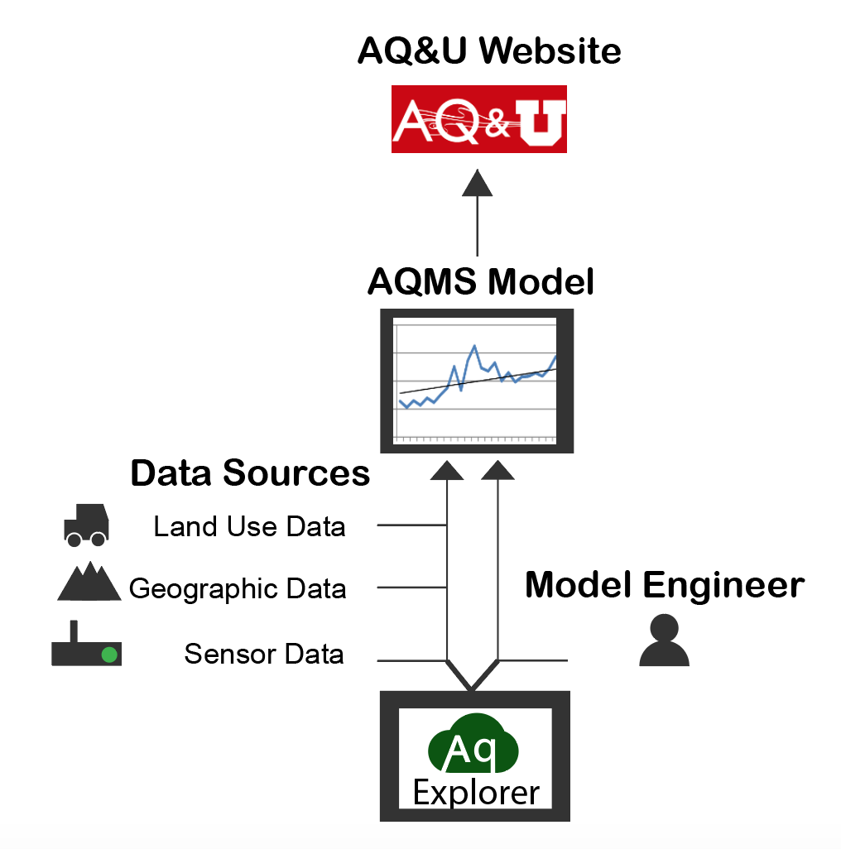
I built AQ Explorer to connect the model engineer to the ‘events’ in the data.

Slide 9

AQ Explorer automates spike detection using a peak detection algorithm.
AQ Explorer obtains sensor data and model estimates.
AQ Explorer displays results to engineer.

Slide 10
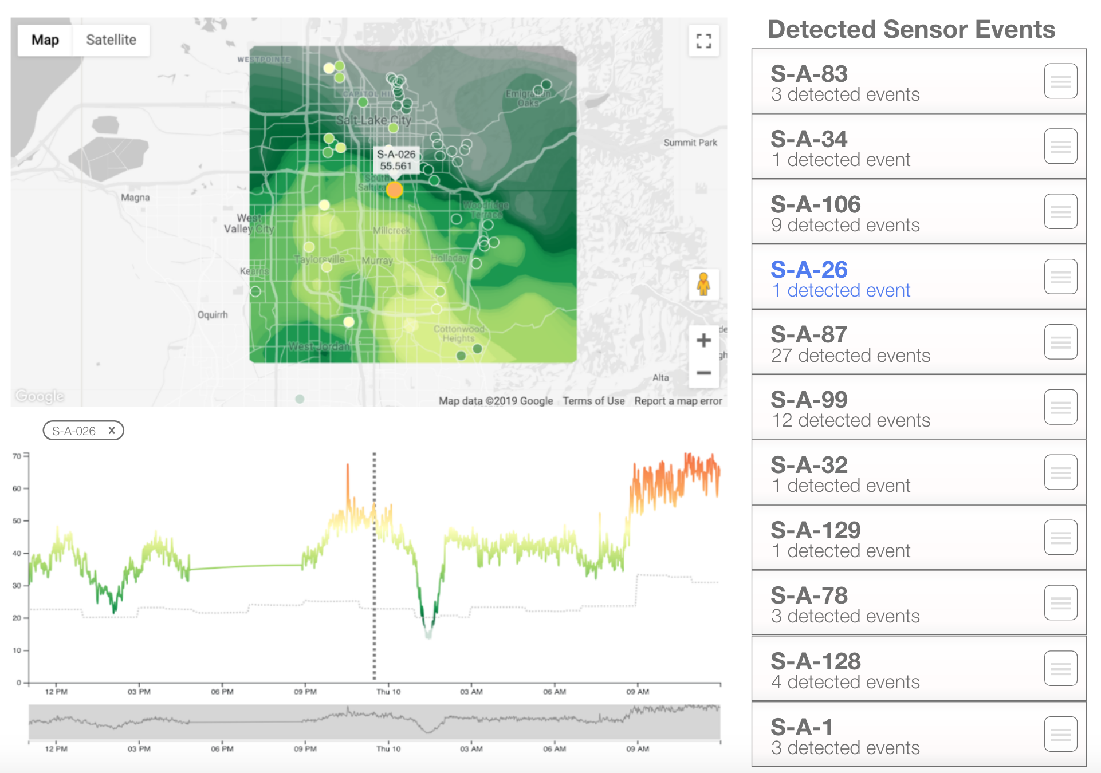
AQ Explorer is a tool created to find these air quality events and display model data.
This tool lets engineers understand what data the model is exposed to.
A
C
A - A geographic map of where the sensor is.
B - A list of detected air quality events.
C - A time series plot of the sensor and model data.
B
Notes:
The details in this aren’t important but the big things.

Slide 11

Verification testing was completed to ensure proper functionality.
Unit Testing
Integration Testing

Slide 12
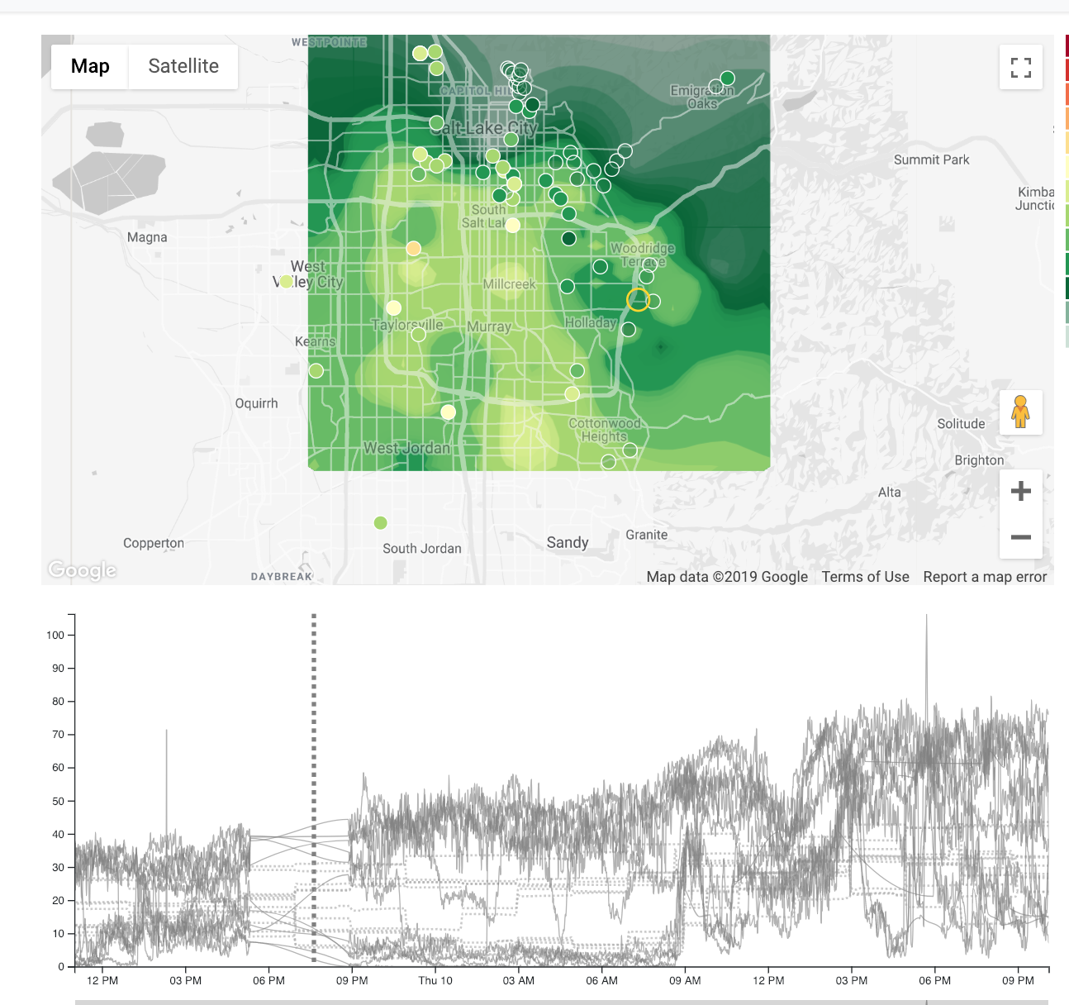
AQ Explorer indicated failed server.

Slide 13
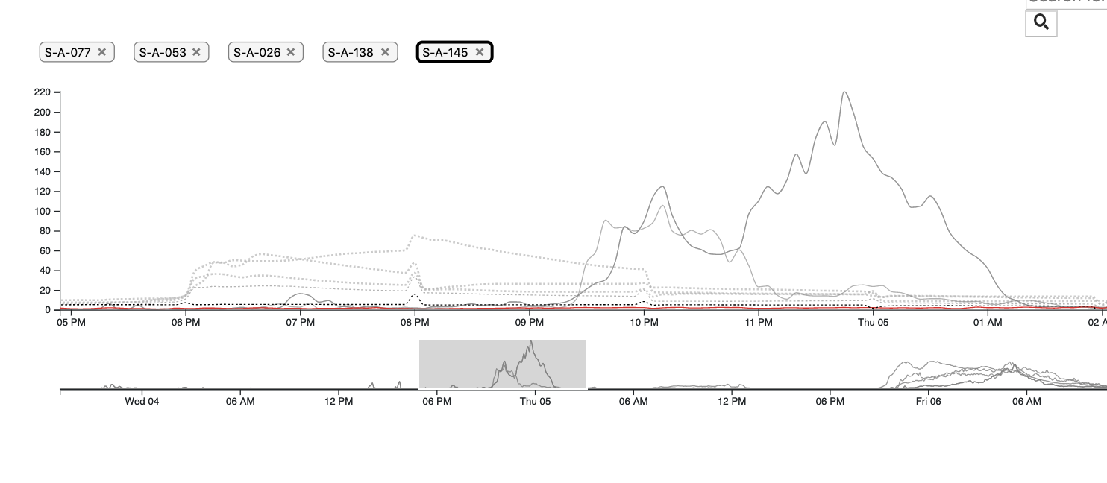
AQ Explorer revealed that the model ‘pre-predicts’ large events.

Slide 14
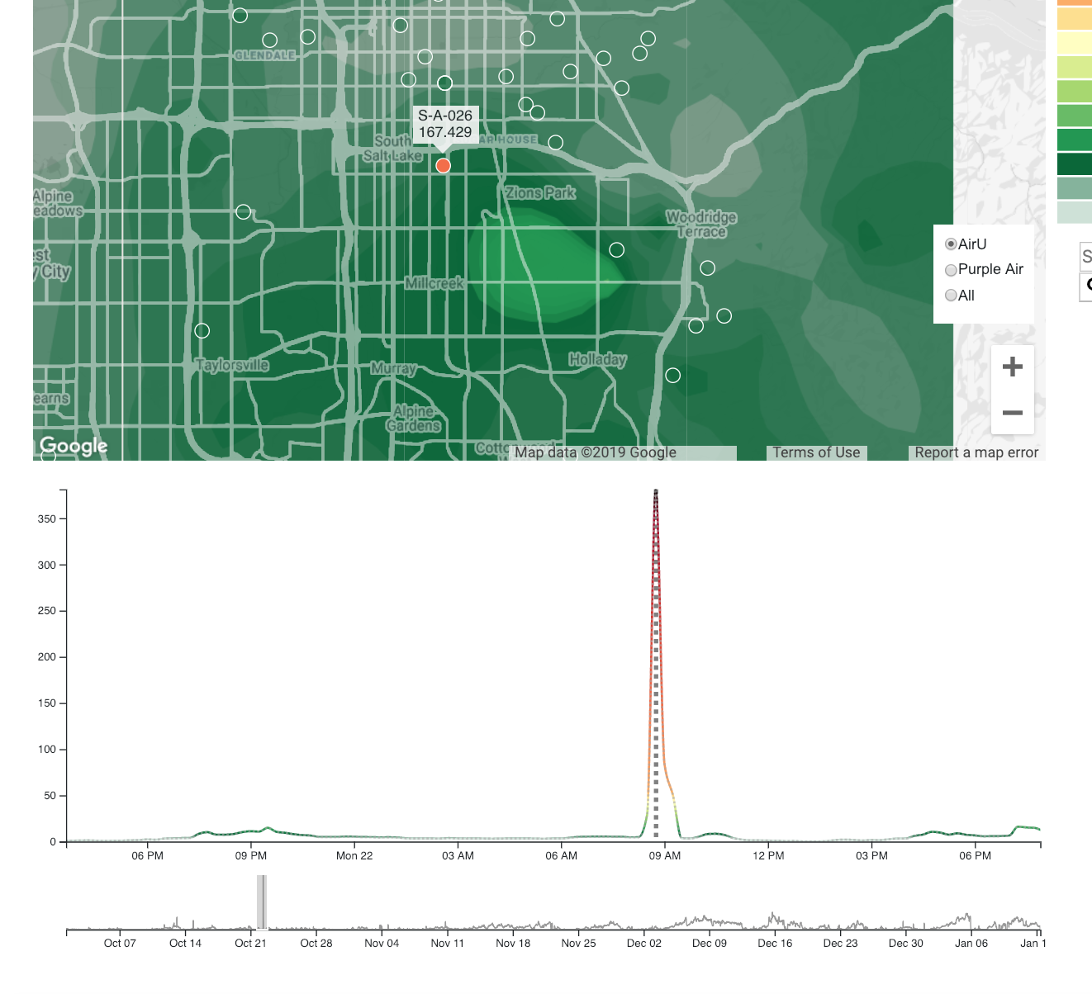
AQ Explorer indicated faulty sensors.

Slide 15
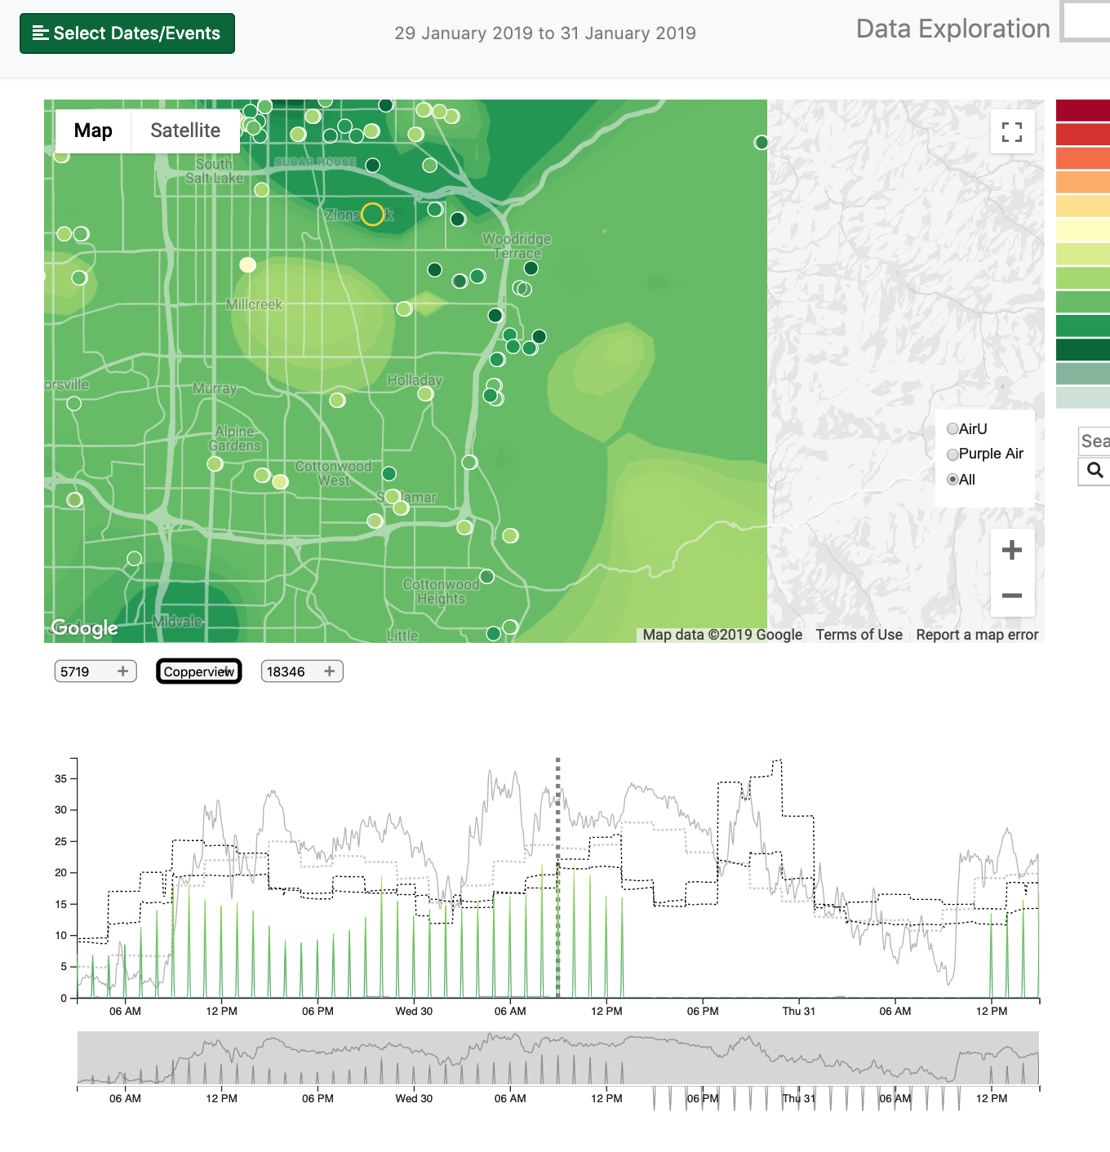
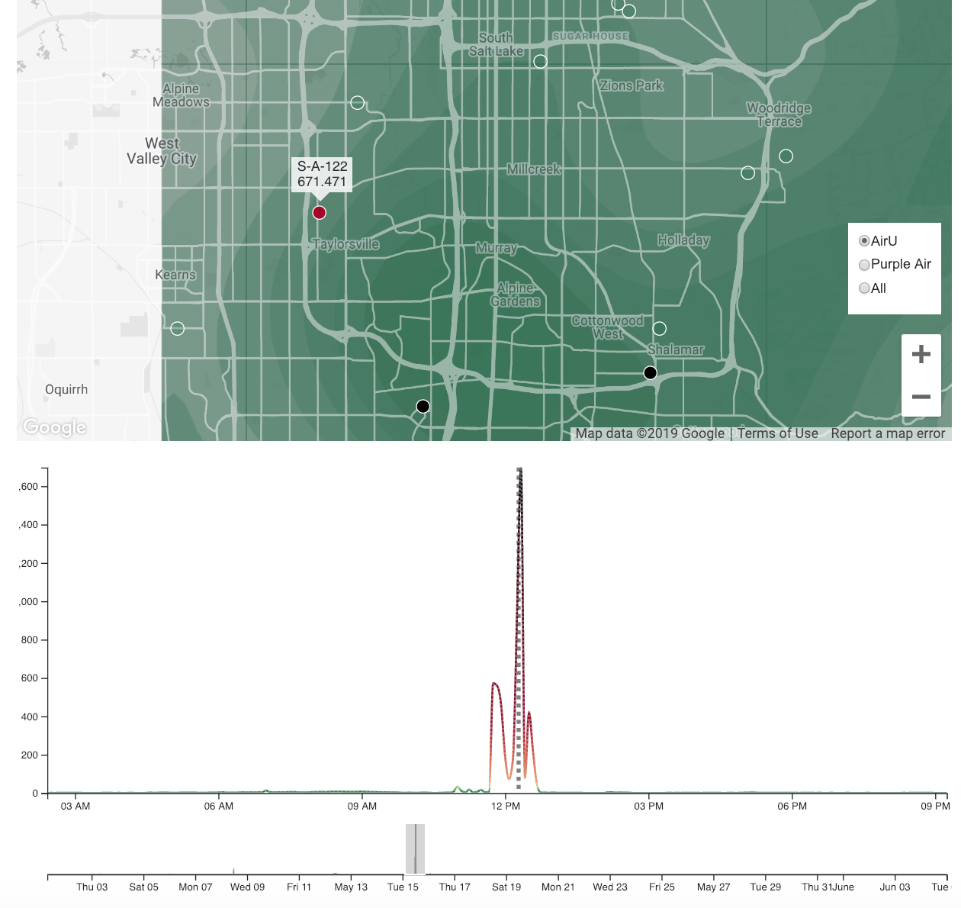
A lot of faulty sensors.

Slide 16
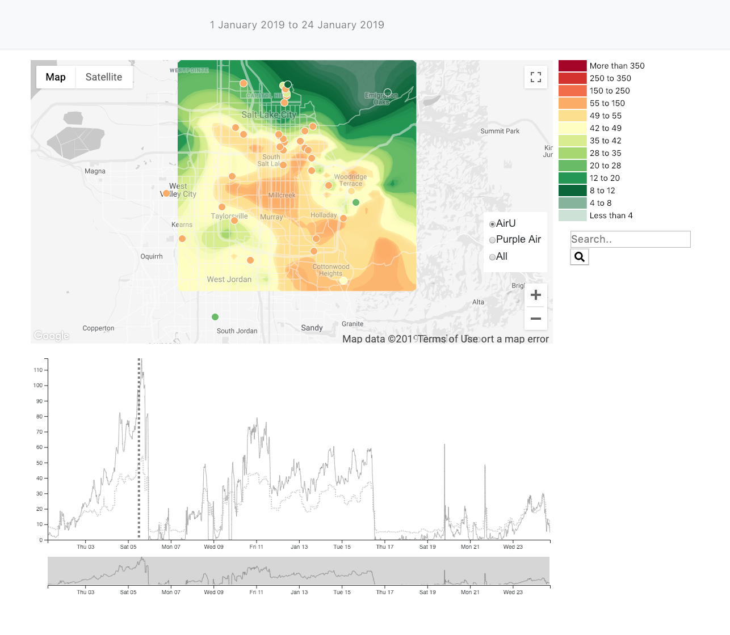
AQ Explorer can demonstrate inversions.

Slide 17
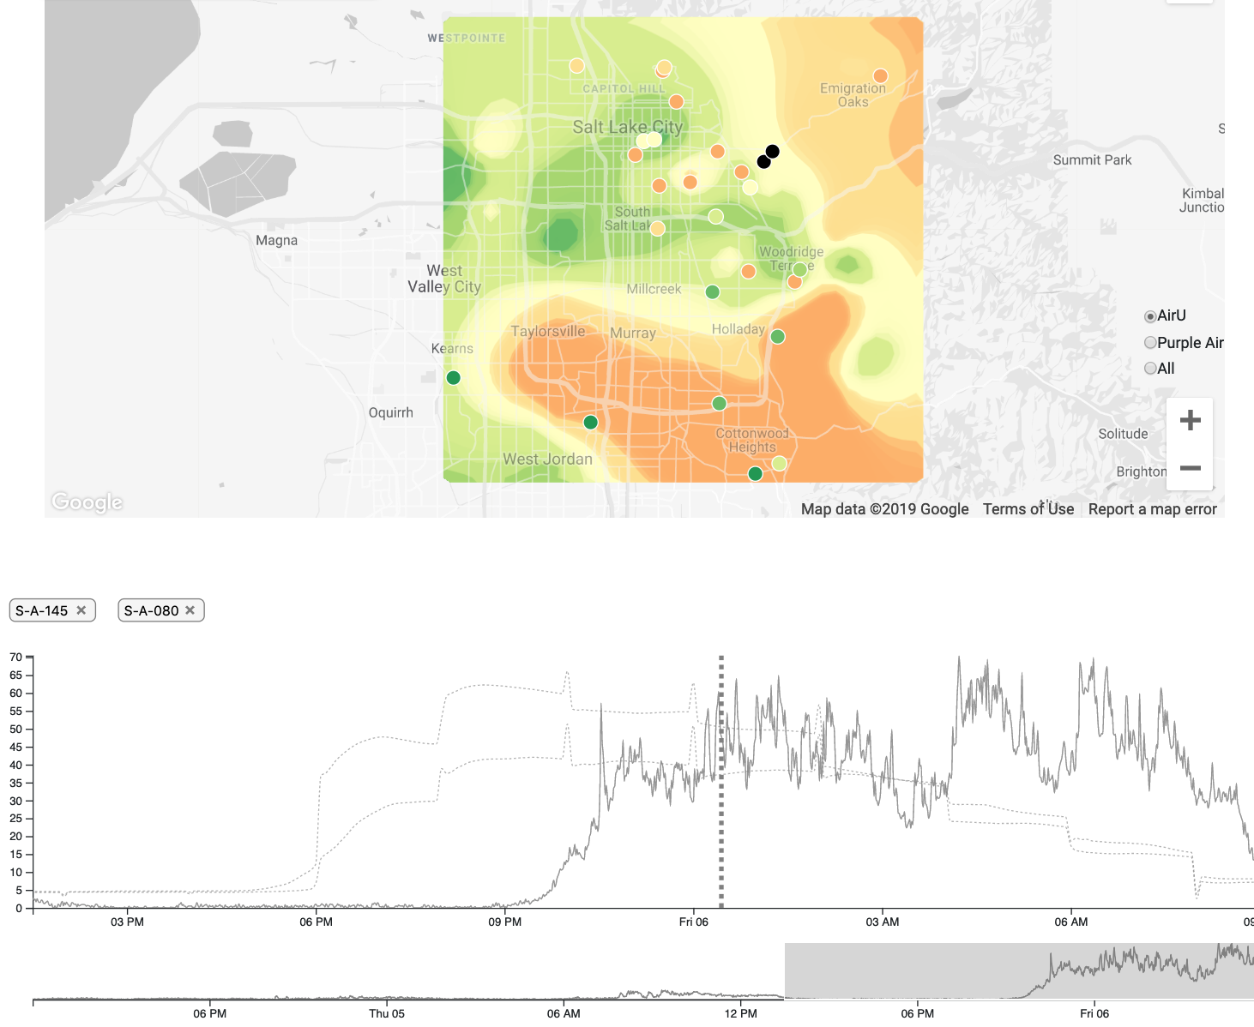
AQ Explorer can also demonstrate forest fires.

Slide 18


Future work involves the development of a suite of tools.

Slide 19
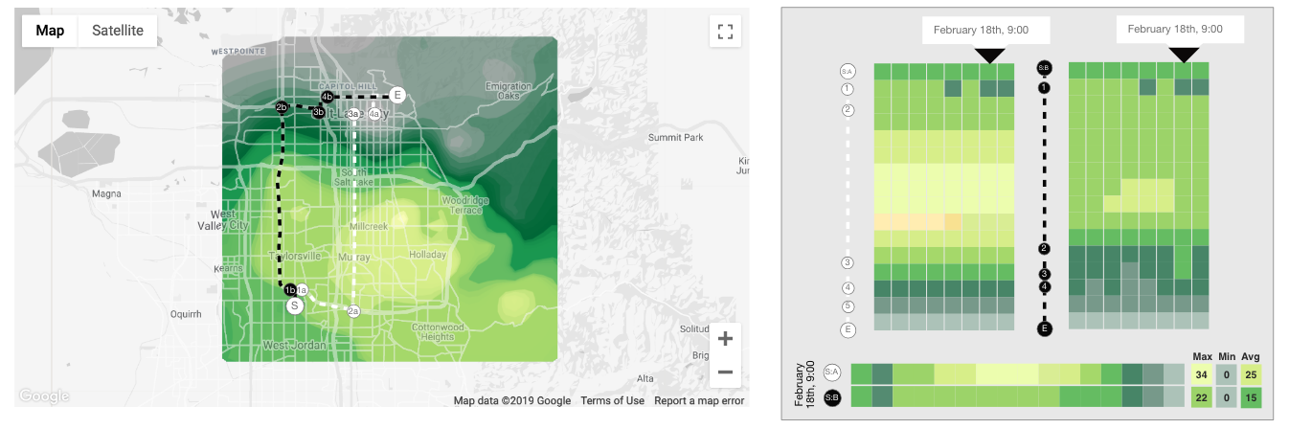
AQ Path Explorer is a public facing tool allowing you to analyze data along routes or places.

Slide 20
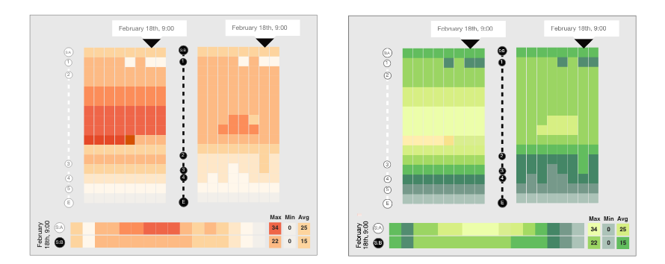
AQ Path Explorer will also be used for color scale comparisons.

Slide 21
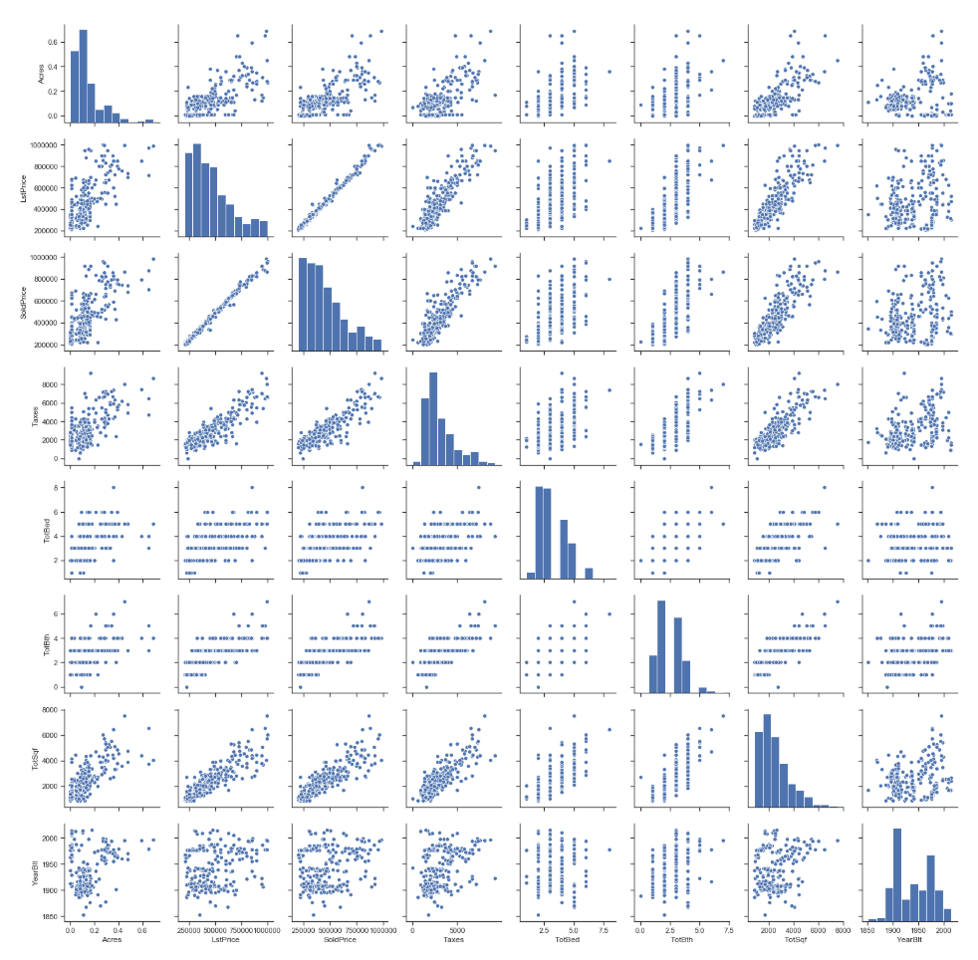
Statistical Pollution Explorer focuses on correlations between pollution an other variables.
Our tools enable the next generation of pollution research.

Slide 22
Better data means better outcomes.

Slide 24
References
[1] Yu-Fei Xing, Yue-Hua Xu, Min-Hua Shi, and Yi-Xin Lian. The impact of PM2.5 on the human respiratory system. Journal of Thoracic Disease. January 2016. https://www.ncbi.nlm.nih.gov/pmc/articles/PMC4740125/
[2] Brian Moench. Utah docs say inversion contributes to premature deaths. Jan 2013. http://archive.sltrib.com/article.php?id=55686497&itype=cmsid
[3] S. Steinle, S. Reis, and C. E. Sabel. Quantifying human exposure to air pollution– moving from static monitoring to spatio-temporally resolved personal exposure assessment. The Science of the total environment, 443:184–93, jan 2013.

